Slide 1

MARKET SEGMENTATION
Name : Gagana Uday Kumar
MyUTSA id: WOV796

Slide 2
Design the Market Segmentation
Target Variable
DONUTS / DOUGHNUTS - BRANDS MO KRISPY KREME
Single Driver Variable
I FEEL GUILTY WHEN I EAT SWEETS
PREFER FOOD PRESENTED AS AN ART FORM
Abstract construct #1 - Travel
Descriptor variables
I LOVE THE IDEA OF TRAVELING ABROAD
WILLING MAKE TRVL PLAN WITH UNKNWN COMP
RATHER TAKE TWO/THREE SHRT QUICK VACATNS
VAC. SOMEWHERE DIFFERENT EVERY TIME
BRKFST IS MORE IMPRTNT THN LUNCH OR DNNR
EATING FAST FOOD HELPS ME STAY IN BUDGET
Abstract construct #2 – Social Interaction
I MAKE FRIENDS EASILY
PEOPLE SAY MY ENTHUSIASM IS CONTAGIOUS
I LIKE TO INTRODUCE PEOPLE TO EACH OTHER
GOOD AT CONVINCING OTHERS TRY NEW THINGS
Major competitors - DUNKIN' DONUTS
Advertised Channel - YOUTUBE.COM
Personal Information-Gender MALE , FEMALE
Origin/ Race - RESPNDNT-SPANISH/HISPANIC/LATINO ORIGIN? YES , NO

Slide 3
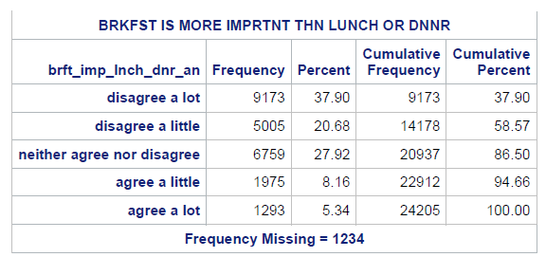
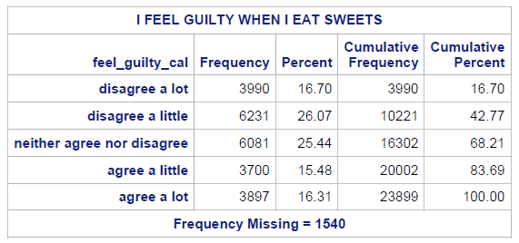
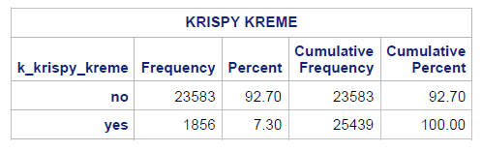
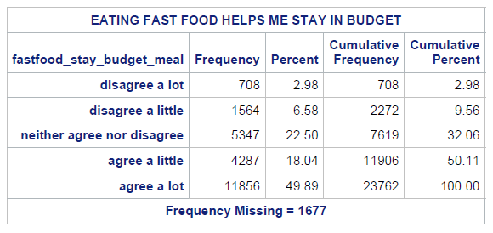

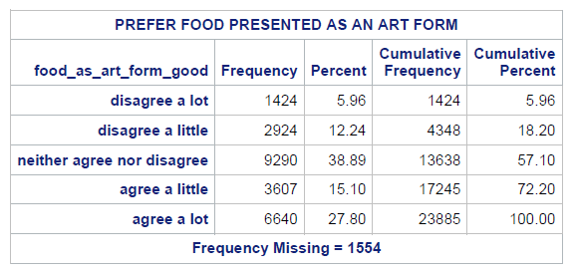

Reading in Raw Data and Creating New Variables

Slide 4

Principle Component Analysis
Extraction Technique – Principle Component Analysis
Rotation Method – Varimax
criteria for determining that a factor was extracted : Kaiser Criterion(eigen value=>1)
Factor extracted – 2
Variance explained - 51.16%

Slide 5
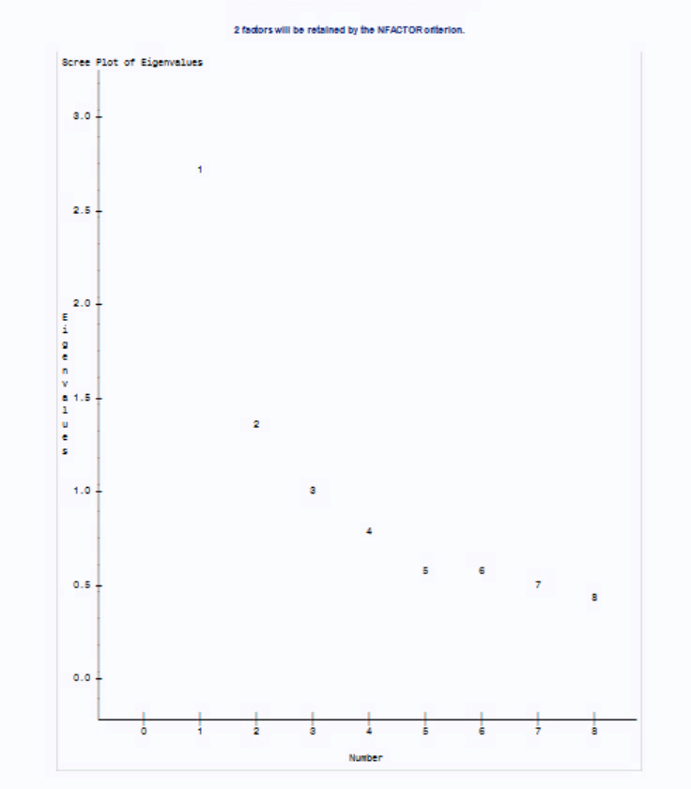
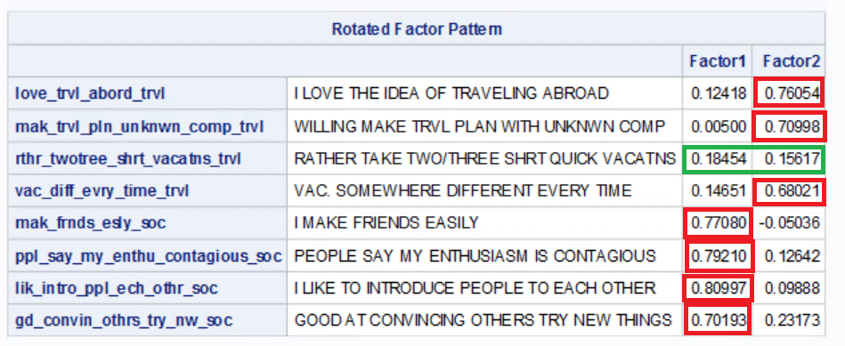
Principle Component Analysis – Scree Plot
Factor Pattern matrix
The Variable rthr_twotree_shrt_vacatns_trvl has no suitable factors
Eliminate Variable and repeat steps
The two factors extracted are:
Travel: People who eat Krispy kreme travel a lot
Social Interaction: People who eat krispy kreme are extroverts.
Scree Plot
The gradient slope are the eigenvalues
n-1 factor that is 3-1=2 factors are represented on the scree plot

Slide 6

PCA Removing the variable rthr_twotree_shrt_vacatns_trvl
Extraction Technique – Principle Component Analysis
Rotation Method – Varimax
criteria for determining that a factor was extracted : Kaiser Criterion(eigen value=>1)
Factor extracted – 2
Variance explained - 57.95%

Slide 7

PCA Removing the variable rthr_twotree_shrt_vacatns_trvl
Factor Pattern matrix
All the variables now have factors which can be chosen.
The two factors extracted are:
Travel: People who eat Krispy kreme travel a lot
Social Interaction: People who eat krispy kreme are extroverts.
Scree Plot
The gradient slope are the eigenvalues
n-1 factor that is 3-1=2 factors are represented on the scree plot

Slide 8
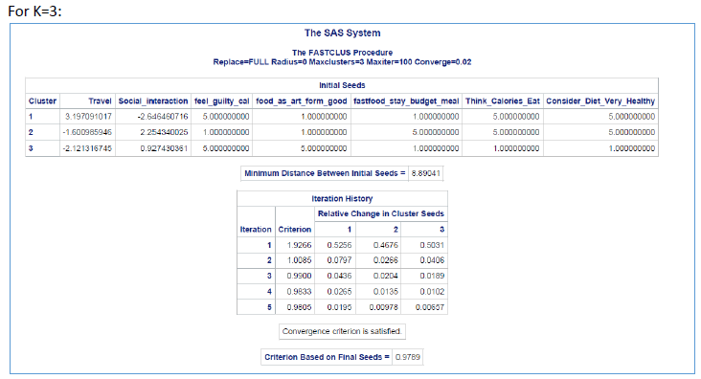
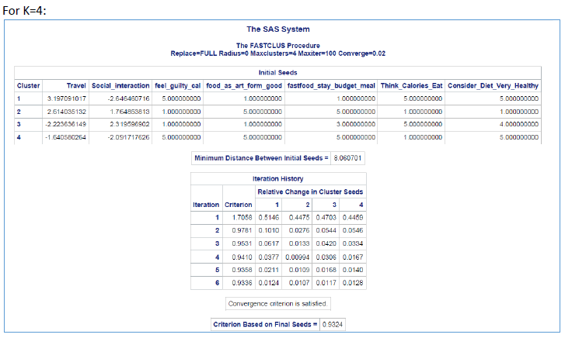
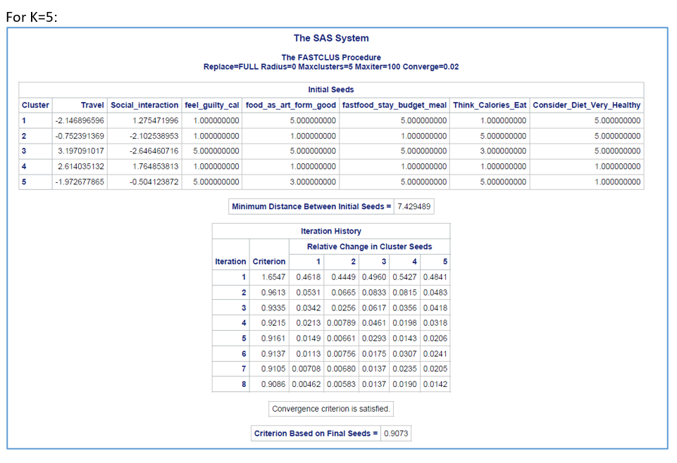
K Means Clustering
K means cluster analysis using PROC CLUSTER
Dropped single variable – BRKFST IS MORE IMPRTNT THN LUNCH OR DNNR (as CCC values below -20 for every variable)
Replaced it with 2 other single Variables
I THINK OF THE CALORIES IN WHAT I EAT
CONSIDER MY DIET TO BE VERY HEALTHY

Slide 9
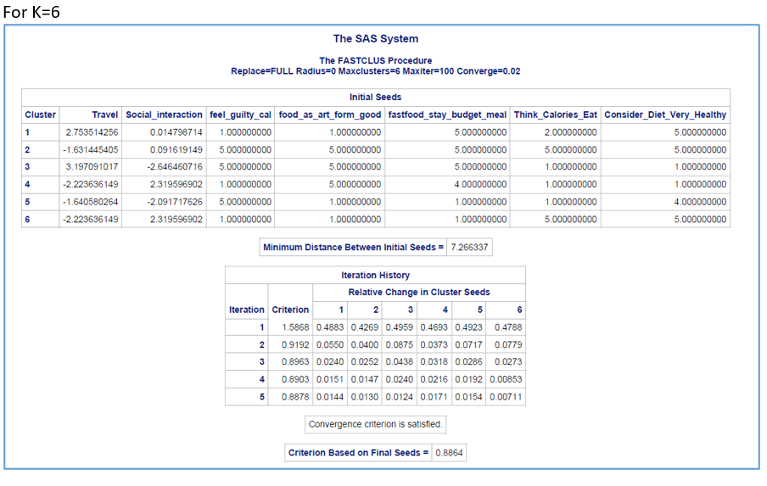
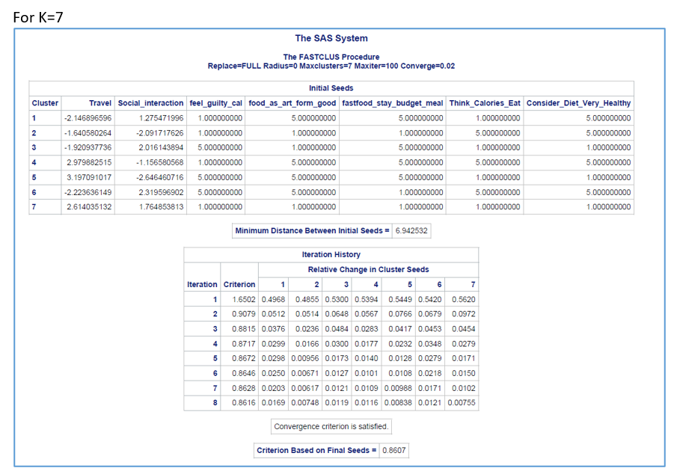
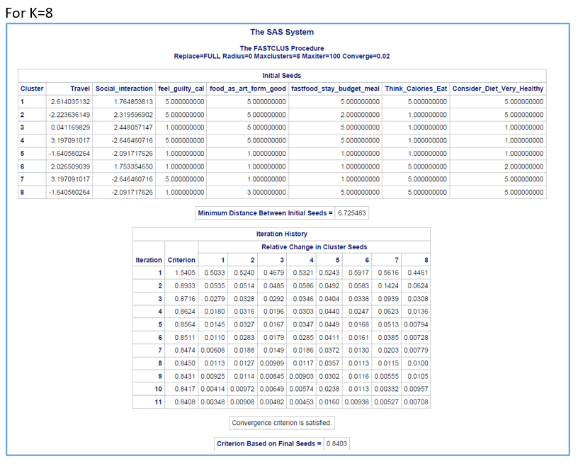
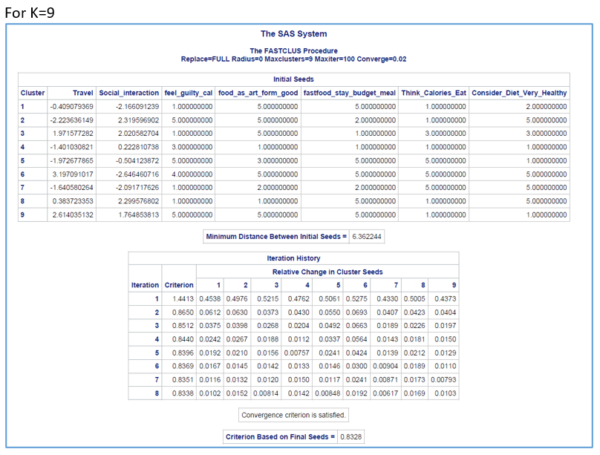

Slide 10
K Means Clustering
CCC : The first local maximum number of is k=7(cluster 7)
The Pseudo F plot does not exhibit a clear first local maximum number of clusters as it shows a gradual slope.
K | Number of clusters | R square | CCC | Pseudo F
3 | 3 | 0.23506 | 34.146 | 4494.41
4 | 4 | 0.30671 | 29.029 | 4148.73
5 | 5 | 0.35866 | 10.482 | 3644.44
6 | 6 | 0.40204 | -7.262 | 3293.81
7 | 7 | 0.43147 | -1.428 | 3160.71
8 | 8 | 0.45767 | -1.313 | 3014.21
9 | 9 | 0.47566 | -11.991 | 2747.19

Slide 11

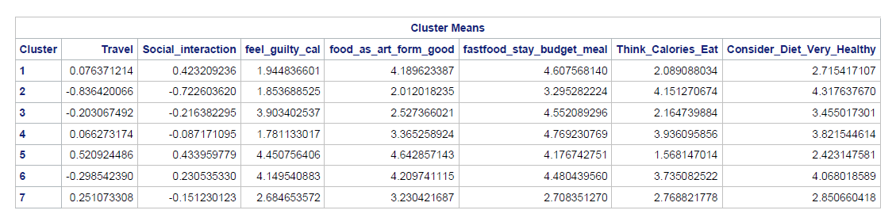
K Means Means of the driver variables
This looks like a good solution because the single driver variables have a decent to good spread (difference)
After Analyzing the difference within the cluster variable’s (0.1 as difference) I found the below :
n! / r!(n-r)! = 7! / 2!(7-2)! = 5040/240 = 21
21*7 (single driver+ abstract constant) = 147
Found 10 Ties after differencing the means
10/147 = 0.06803 *100 = 6.8%
Good solution as the percentage does not cross 15% and it is 6.8% of ties

Slide 12
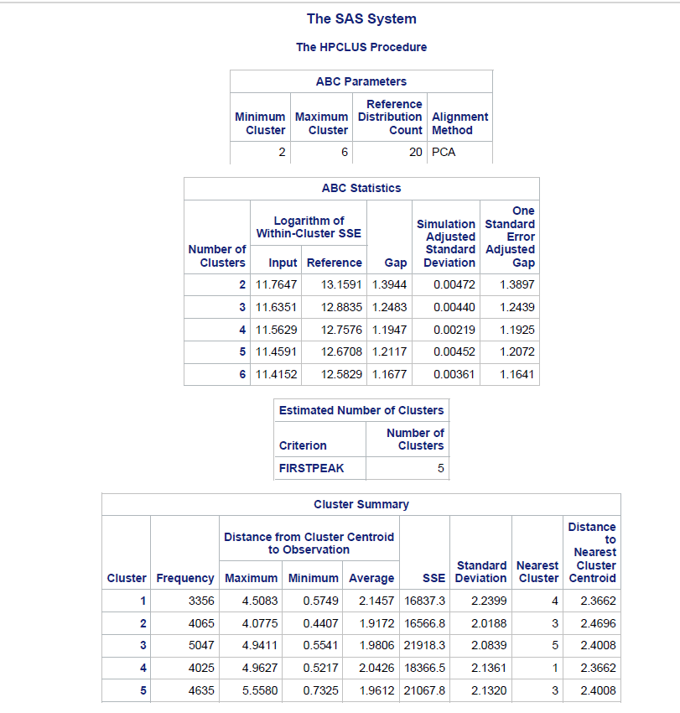
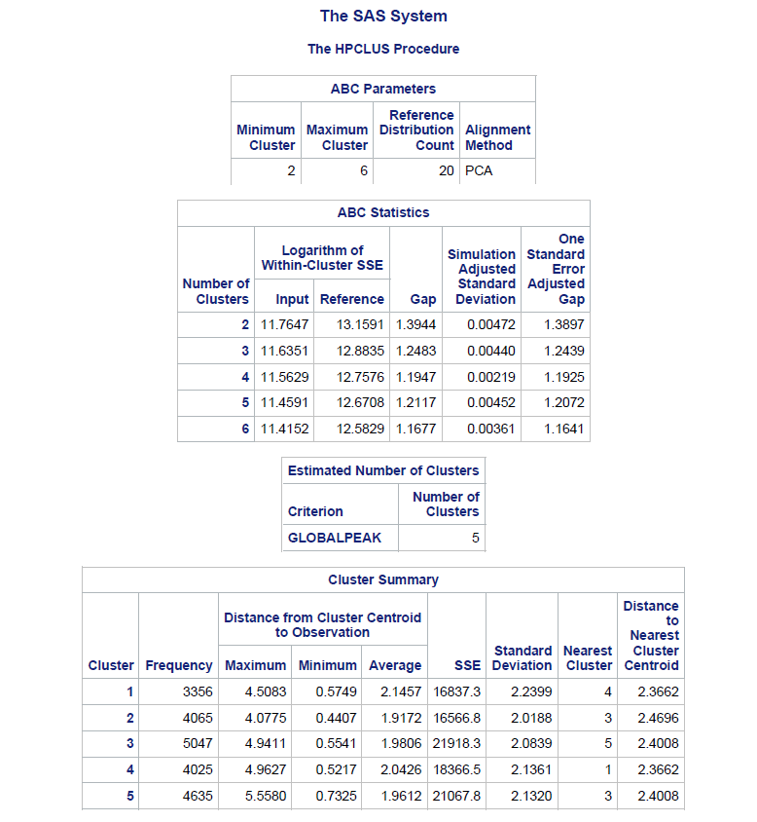
Gap Analysis
Removed one single variable as the clusters I got was 2 with the previous single variables which was not very optimum
Number of clusters for the firstpeak to be 5 which is optimum
Number of clusters for the globalpeak to be 5 which is optimum

Slide 13
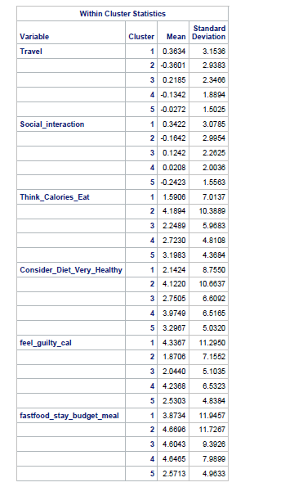
Gap Analysis
Cluster means for the drivers
Considered the means from the Firstpeak and it seems like there is decent discrimination.
n! / r! (n-r)! = 5! / 2! (5-2)! = 120/12 = 10
10*6 = 60
9 Ties (Working show in the excel attached)
9/60 = 0.15 *100 = 15%
This looks like a decent discrimination among the clusters for the driver variables as the percentage does not cross 15% and it has exactly 15% of ties
K means Vs HPCLUS suggested number of clusters
K means: The number of cluster I got through CCC is 7.
HPCLUS, the number of clusters I got was 5
I would select the K means cluster as it has 7 clusters, and it seems to be more optimum than the HPCLUS clusters

Slide 14
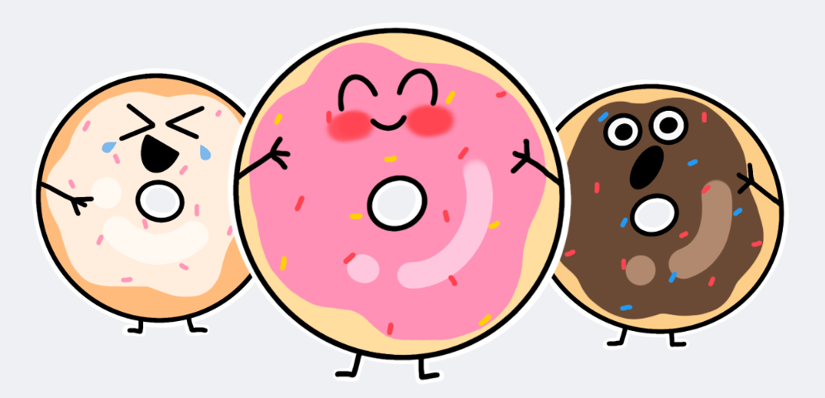
Cluster Analysis Across Descriptor Variables
Used K=7 cluster solution as it worked best in the Previous exercise
Considered 0.1 as the difference
n! / r! (n-r)! = 7! / 2! (7-2)! = 5040/240 = 21
21*5 (descriptor variables) = 105
By considering 1% difference, we have:
13 Ties -> 13/105 = 0.1238*100 = 12.38%
We have 13 ties which is 12.38% of the overall ties
Above output says the variable means are far apart from each other
This has good number of ties as this does not exceed 15%. Therefore, the clustering solution discriminates on the descriptor variable well.
Hence, cluster(k)=7 is an appropriate cluster choice for the market segmentation analysis.
 | Cluster=. | Cluster=1 | Cluster=2 | Cluster=3 | Cluster=4 | Cluster=5 | Cluster=6 | Cluster=7
K_Krispy_Kreme | 0.033033 | 0.082511 | 0.050963 | 0.085295 | 0.057314 | 0.096478 | 0.059162 | 0.074715
D_Dunkin_Donuts | 0.258258 | 0.181726 | 0.227256 | 0.195514 | 0.18777 | 0.182007 | 0.202136 | 0.219259
Y_Youtube | 0.159159 | 0.389269 | 0.380899 | 0.430906 | 0.404317 | 0.362829 | 0.322104 | 0.396173
gender_resp | 0.468469 | 0.386484 | 0.383541 | 0.453337 | 0.335731 | 0.572359 | 0.437962 | 0.498371
RESPNDNT_ORIGIN | 0.543544 | 0.243736 | 0.454134 | 0.282747 | 0.303118 | 0.23794 | 0.271159 | 0.34202

Slide 15
Cluster Analysis Across Descriptor Variables
 | Highest | Lowest
K_Krispy_Kreme | Cluster 5 has the highest mean value of 9.64%, indicating a high preference for Krispy Kreme | Clusters 2 has lowest mean value with 5.09%, suggesting a lower preference for Krispy Kreme
D_Dunkin_Donuts | Cluster 2 has the highest mean value of 22.72%, indicating a strong preference for Dunkin Donuts over Krispy Kreme. | Clusters 1 has the lowest mean value of 18.17% indicating a strong preference for Krispy Kreme over Dunkin Donuts
Y_Youtube | Cluster 3 has the highest mean value of 43.09%, indicating they have higher chance of watching ads over Youtube | Clusters 6 has lowest mean values of 32.21% indicating they have lower chance of watching ads over Youtube
Gender_resp | Cluster 5 has the highest mean value of 57.23%, suggesting a higher representation of a male gender | Clusters 4 has lowest mean values of 33.57% suggesting a lower representation of a male gender
RESPNDNT_ORIGIN | Cluster 2 has the highest mean value of 45.41%, indicating a higher proportion from a SPANISH/HISPANIC/LATINO origin | Clusters 5 has lowest mean values of 23.79% indicating a lower proportion from a SPANISH/HISPANIC/LATINO origin

